Slide 1
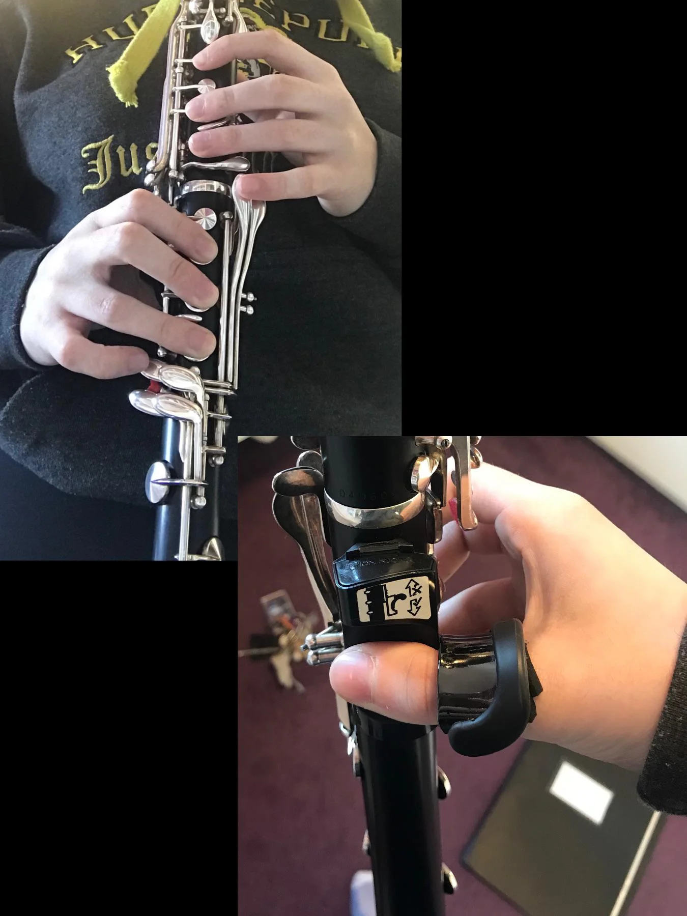
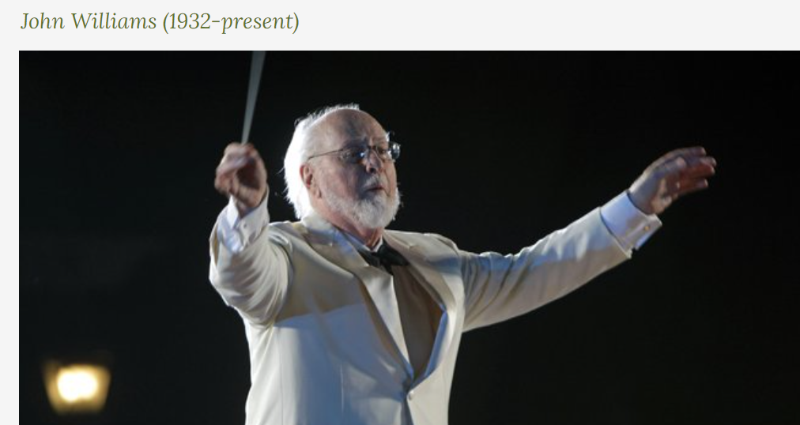
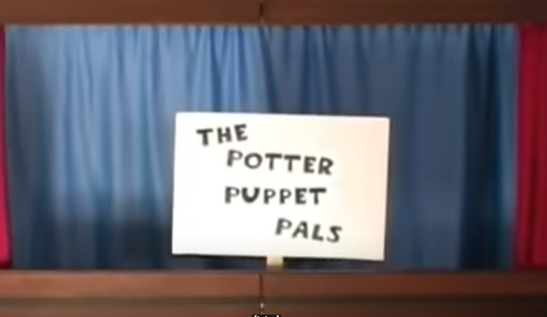
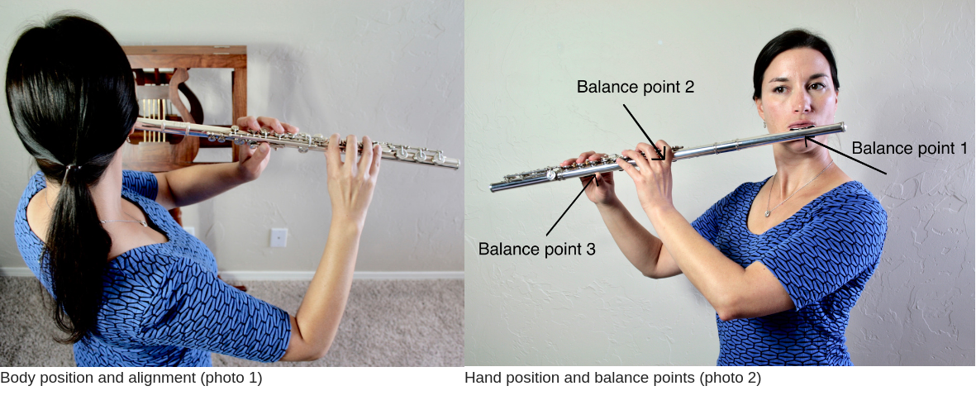
Wider Opportunities – The Music of John Williams Woodwind Year 5 Autumn Term 1 and 2 (continued from Year 4)
We will improve our playing on the Flute or Clarinet
We will continue to look after our instrument at home (RESPONSIBILITY)
We will learn the correct way to use our breath to create dynamics that create mood (REFLECTIVE)
We will expand our note repertoire: at least 6 notes. Some pupils may progress to a full octave.
We will read these notes on a stave, keep in time as we play together and change dynamics as conducted including the use of Italian terms.
We will work on a polished performance for our friends and parents (RESILIENCE)
We will listen and appraise to the music of John WIlliams (CURIOUSITY)
We will compose and improvise on our instrument and other percussion instruments
Key Vocabulary:
We will learn about these interrelated dimensions of music: Pulse, Rhythm, Duration, Texture, Dynamics
We will focus on how music is layered (texture)
We will learn these Italian terms and their meaning:
We will learn about vocabulary specific to our instrument: Reed, Tongue, Finger placement, woodwind

Slide 2
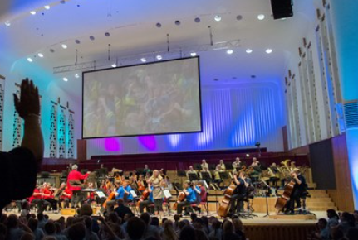
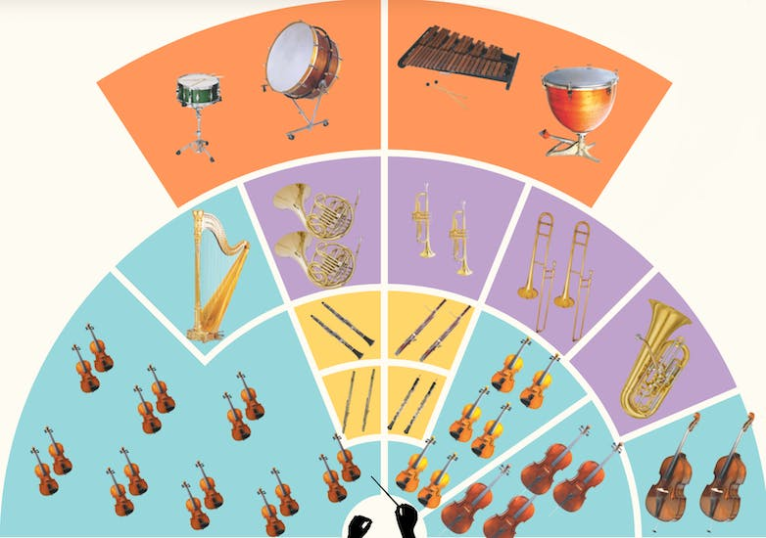
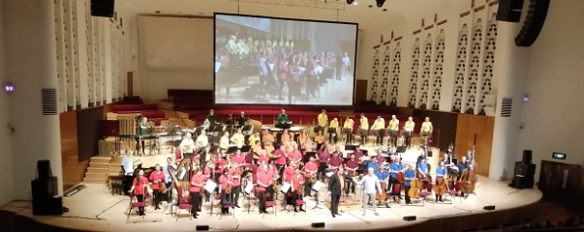
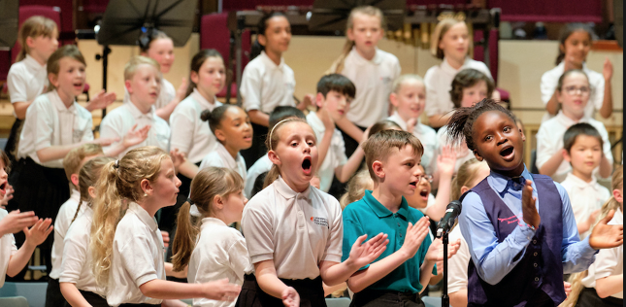
The Royal Liverpool Philharmonic Orchestra School's Concerts
Year 5 Spring Term 1 and 2
We will:
Learn about the families of the orchestra
Listen to some classical and popular music on a theme
Learn a song to sing in collaboration with other schools
Visit the Philharmonic to take part in the concert!
The main aim of this unit is to introduce some of the music that will be played by the orchestra through practical, creative music-making activities.
These opportunities to explore musical themes and dimensions include guiding the children in listening and responding to the music beforehand which will enable them to have a greater enjoyment and appreciation of the concert.
Each year the repertoire will change. Here is an example from 2022:
Fela Sowande Nostalgia, from African Suite for Strings
Hendrik Hofmeyr Ingoma
Antonin Dvořák Scherzo, from Symphony No. 9
Errollyn Wallen Mighty River
Leonard Bernstein Danzon from Fancy Free
William Walton Agincourt Song
Olivier Truan Intermezzo No. 1
Mandy Ross & Ian Stephens Songs of Home in Hope St - Anne-Marie O’Farrell Rann Dó Trí
Each year, the Philharmonic will work with our school staff on a scheme of work that explores quality classical and popular music. The Philharmonic will train our teachers so that they can deliver the scheme of work at St Gregory's with confidence.

Slide 3
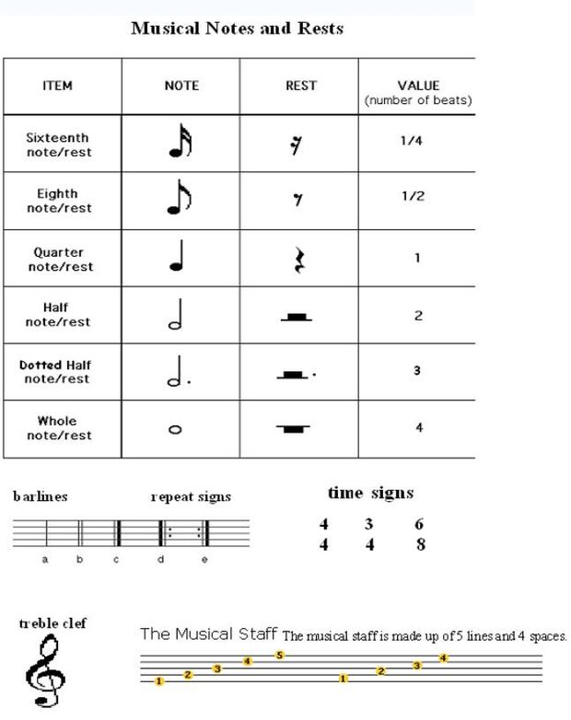
Key Vocabulary:
pitch
short phrases and long phrases.
Improvise
melodic pattern.
melody
duration
rhythmic patterns
ostinati (repeated melody lines)
gesture
and notate.
metre (the way beats are grouped) of 3 or 4.
dynamics
crescendo (gradually getting louder) and diminuendo (gradually getting quieter).
dynamic choices such as accents (sudden loud notes, or sudden quiet notes).
tempo
timbre
texture
Year 5 Music Summer Term
Compose, notate and perform a piece of Amazonian music
Key Learning:
I can create my own musical notation score
I can decide upon the tempo (speed) of changes from one symbol to the next
I can consider the general volume of the performance and whether it is always be at the same dynamic level
I can include improvised sections
About this unit:
Within this theme, children will learn how to compose graphic notation. They will then use this knowledge to compose their own Amazon Adventure listening and memory games that will require them to not only compose, but also perform and understand a notation of their own choice.

